Slide 1

Object Oriented Programming
Behavioral Design Patterns: Observer
IT620
Sourish Dasgupta
Assistant Professor, DA-IICT, Gandhinagar
https://daiict.ac.in/faculty/sourish-dasgupta

Slide 2
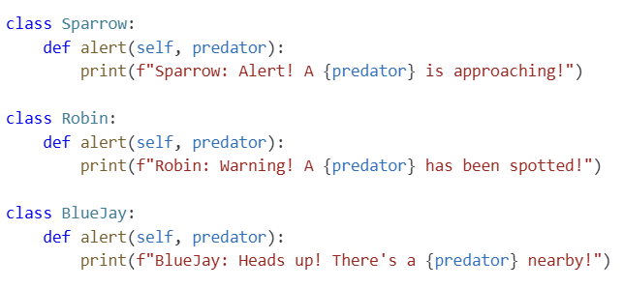
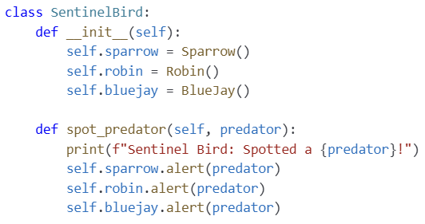
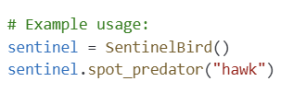
What if objects want to notify each other?
IT620: Behavioral Design Patterns: Observer
Sourish Dasgupta

Slide 3
What’s wrong with the design?
Disadvantage | Explanation
Tight Coupling | The SentinelBird directly references specific bird classes (e.g., Sparrow, Robin) → changes to one require modifying the subject class
Scalability Issues | SentinelBird becomes overloaded with direct dependencies as more birds add in
Reduced Flexibility | Dynamic addition or removal of bird observers at runtime not possible
IT620: Behavioral Design Patterns: Observer
Sourish Dasgupta

Slide 4
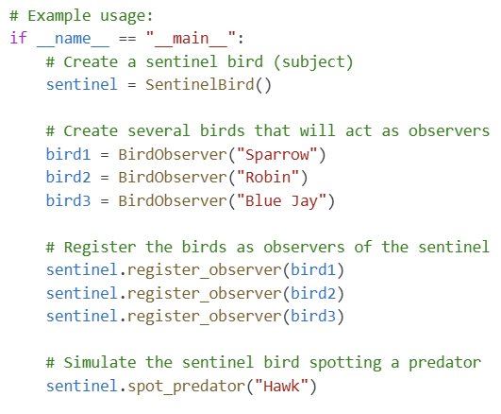
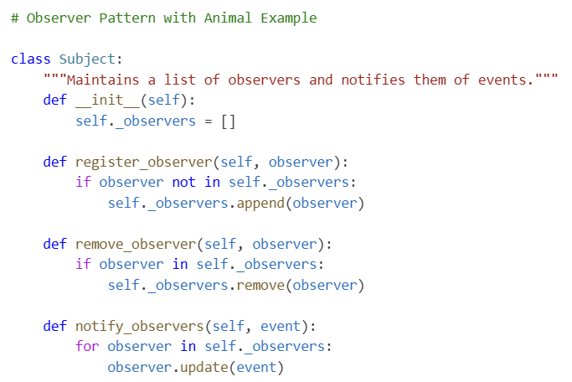
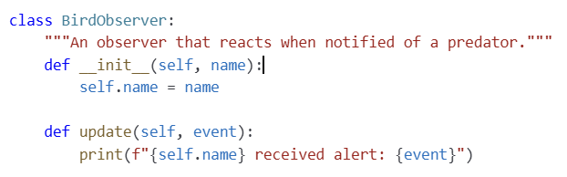
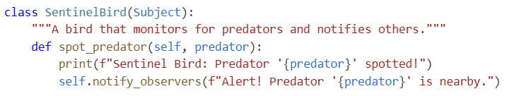
What if objects want to notify each other? The Observer way!!
IT620: Behavioral Design Patterns: Observer
Sourish Dasgupta

Slide 5
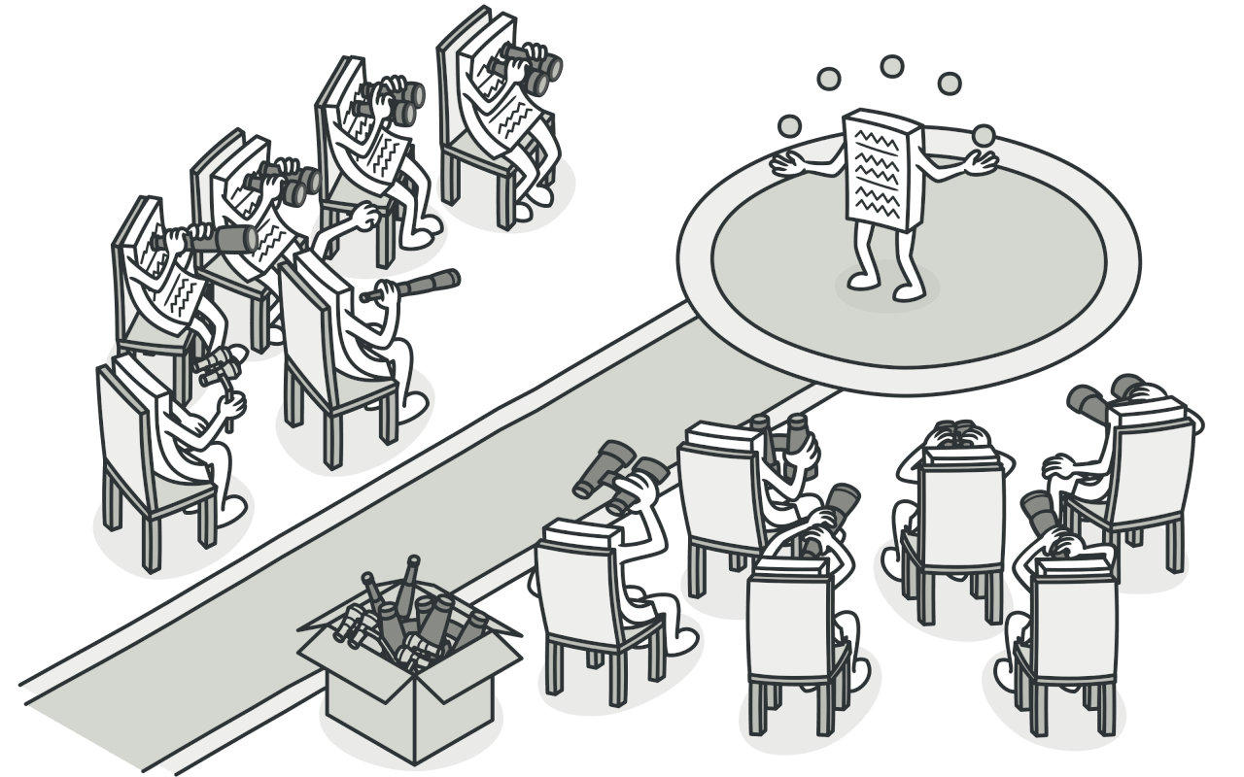
Key Takeaways
Advantage | Explanation
Loose Coupling | Decouples the subject from its observers, reducing dependencies → allows changes without widespread impact
Dynamic Relationships | Observers can be added or removed at runtime → scalable
Improved Maintainability | Separates the notification mechanism from the business logic → easier to update or extend parts of the system without affecting others
Reusability | Can be reused across different subjects or projects, reducing code duplication and promoting modular design
IT620: Behavioral Design Patterns: Observer
Sourish Dasgupta

Slide 6
Synchronous vs. Asynchronous Notifications
IT620: Behavioral Design Patterns: Observer
Sourish Dasgupta

Slide 7
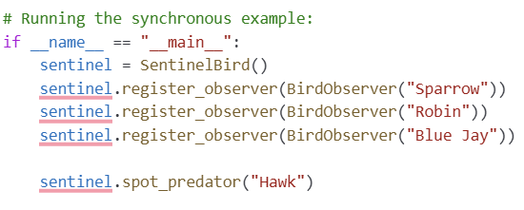
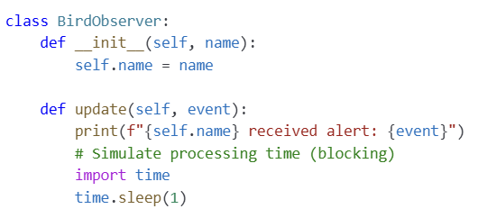
The (default) synchronous notification - Waiting is not good!
Sentinel Bird must wait for each bird to finish processing its alert before moving on to the next.
IT620: Behavioral Design Patterns: Observer
Sourish Dasgupta

Slide 8
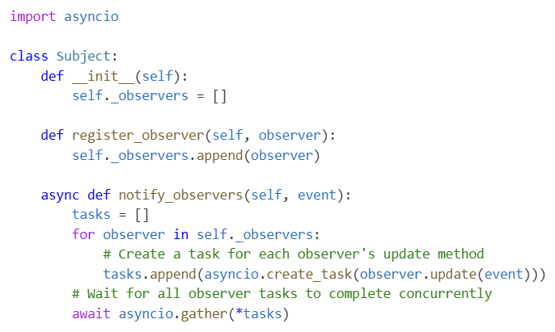
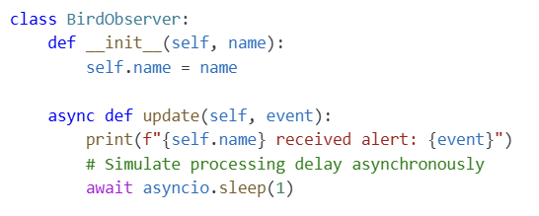
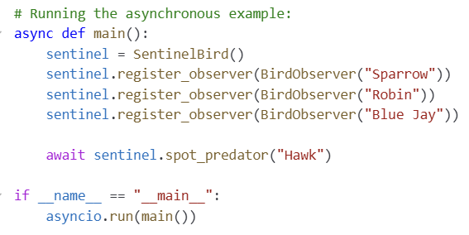
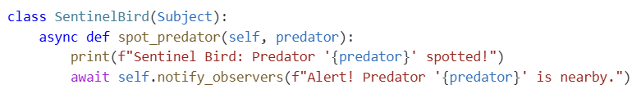
Notify each other without having to wait for anyone! Async
IT620: Behavioral Design Patterns: Observer
Sourish Dasgupta

